Slide 1

Online Flight Booking System
PHP, Mysql Project
--------------NISHANTH D KINI

Slide 2
In particular, this Online Flight Booking System Project in PHP focuses mainly on booking airline tickets. To be more precise, the system helps to keep track of the flight schedule, and their management. Also, the system displays all the round trips and one-way routes. In addition, the system allows setting up cities too(codeastro.com). Evidently, this project contains an admin panel and a simple client side. In an overview of this web application, the user can simply register in order to use the features. Here, passengers can search for flight details. For this, the passenger has to select departure and arrival locations with dates, class, and number of passengers. As a result, the system filters out available flight schedules with detailed information.
- NISHANTH D KINI

Slide 3
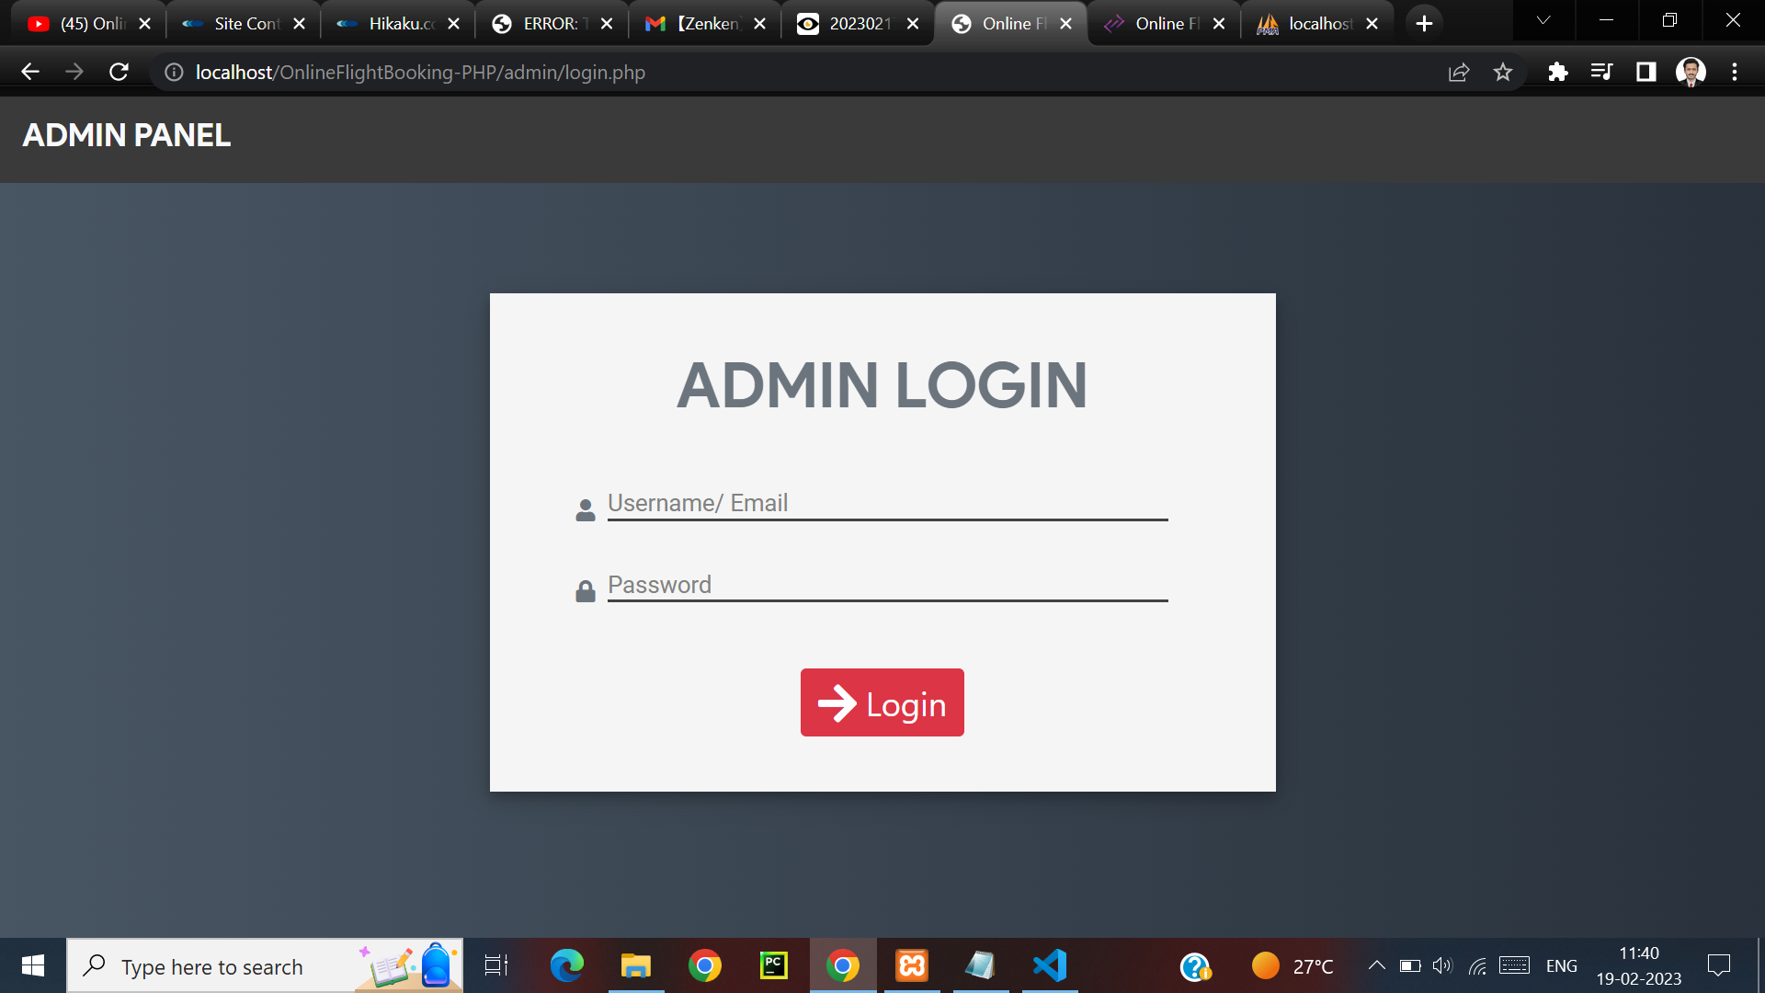
ADMIN LOGIN PAGE WHERE U CAN LOOK FOR THE FLIGHTS TO BE BOOKED

Slide 4
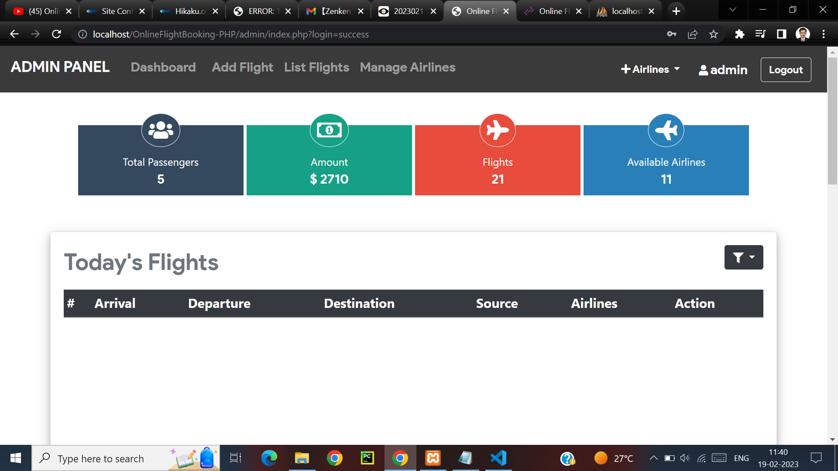
ADMIN PANEL WHERE U CAN ADD FLIGHT, SEE THE LIST OF FLIGHTS ETC

Slide 5
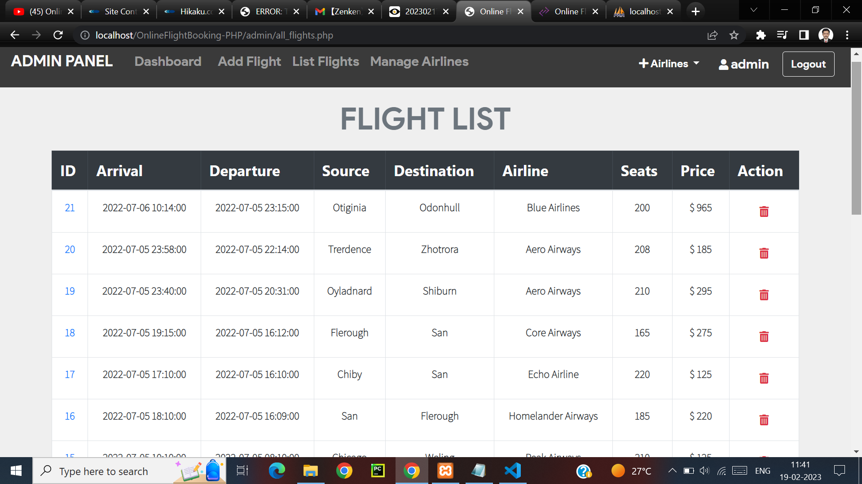
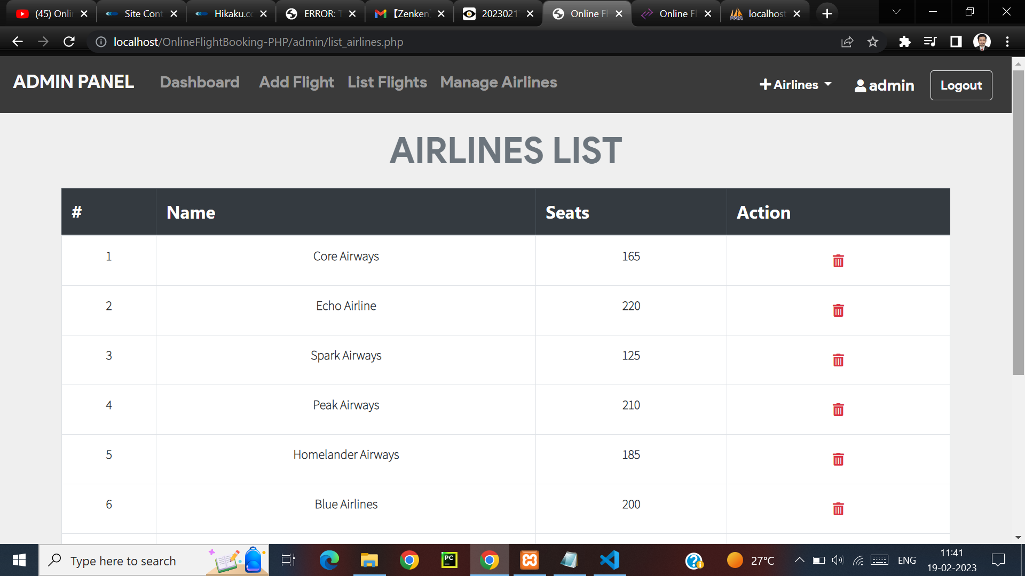
FLIGHT LIST AND AIRLINES LIST

Slide 6
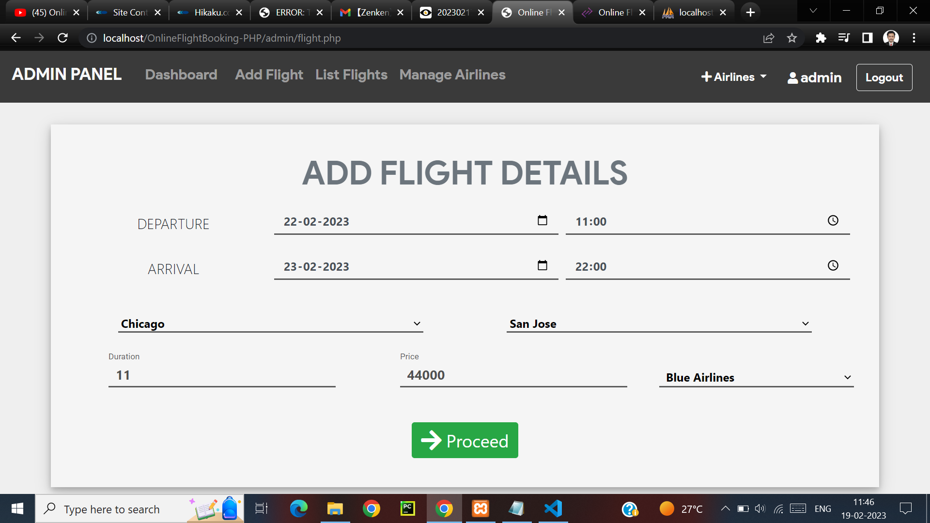
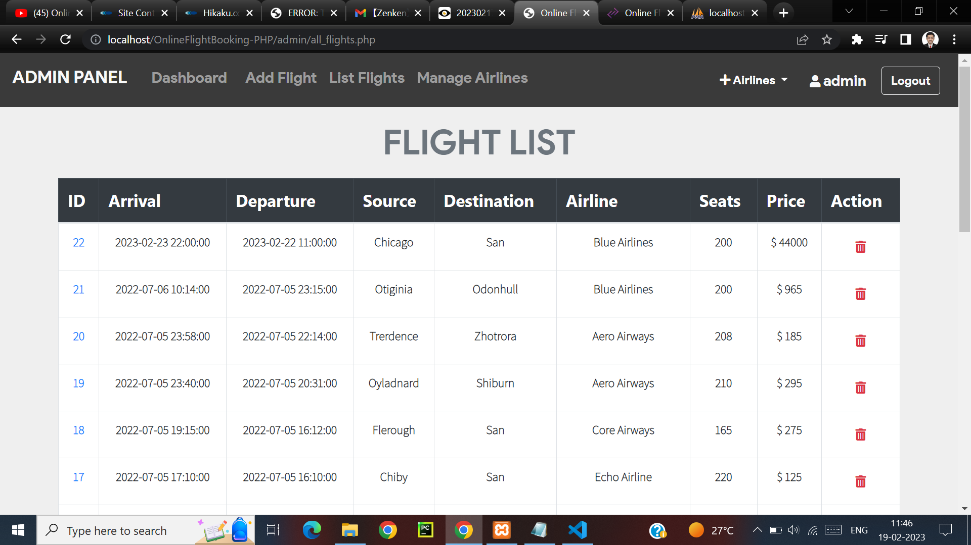
AFTER ADDING THE FLIGHT DETAILS, IT GETS ADDED TO THE FLIGHT LIST.

Slide 7
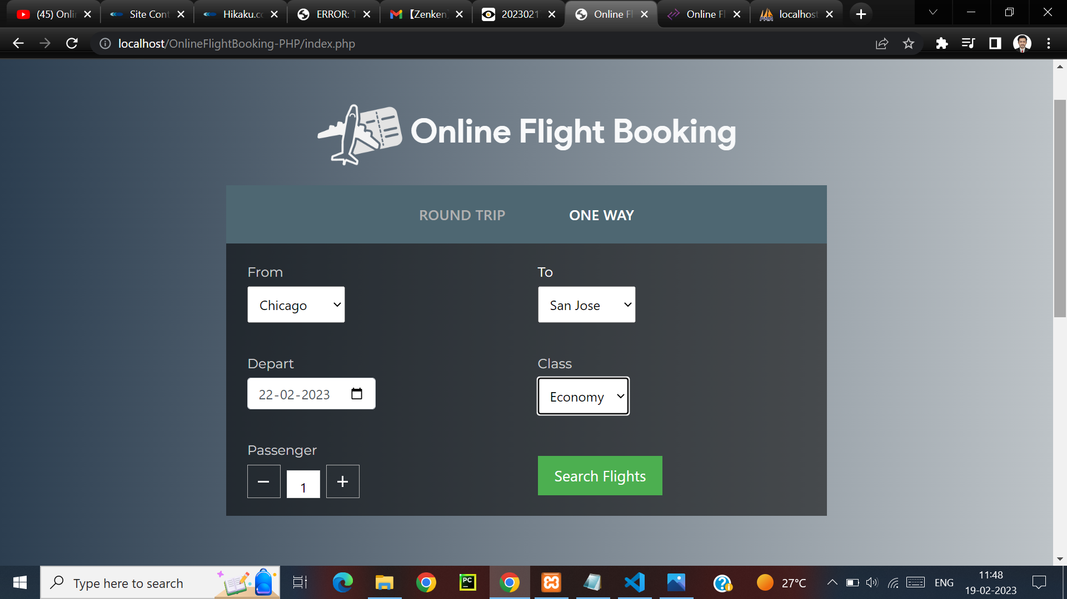
HERE YOU CAN SEARCH FOR THAT PARTICULAR FLIGHT IF AVAILABLE

Slide 8
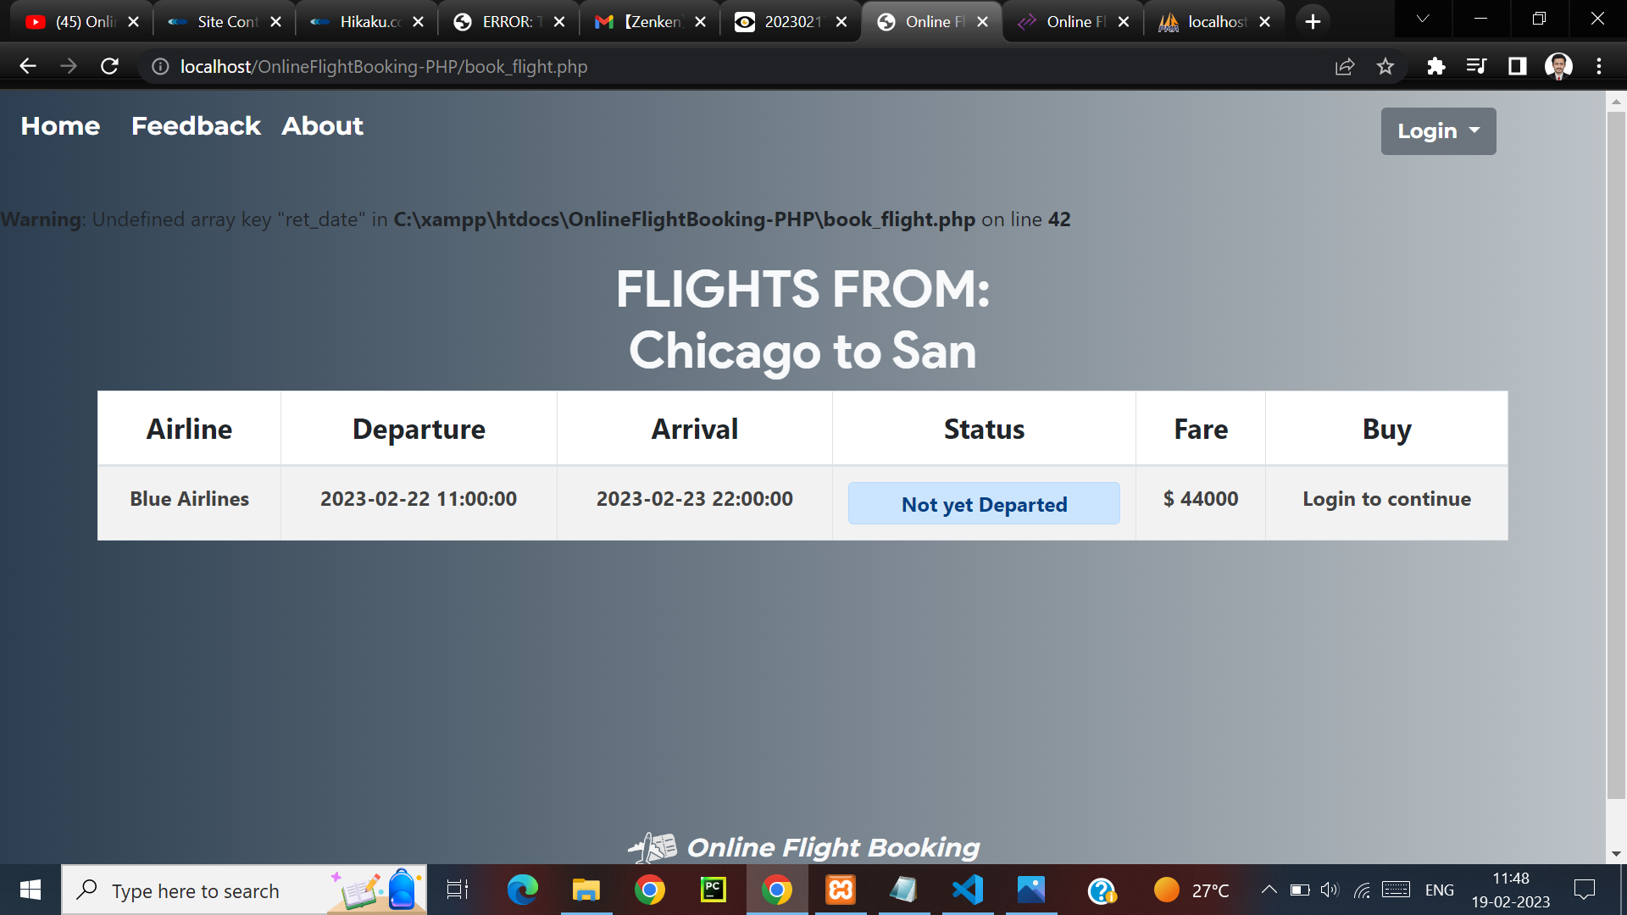
AFTER AVAILABILITY CHECK , THE PARTICULAR FLIGHT APPEARS WHERE U CAN LOGIN AND BUY

Slide 9
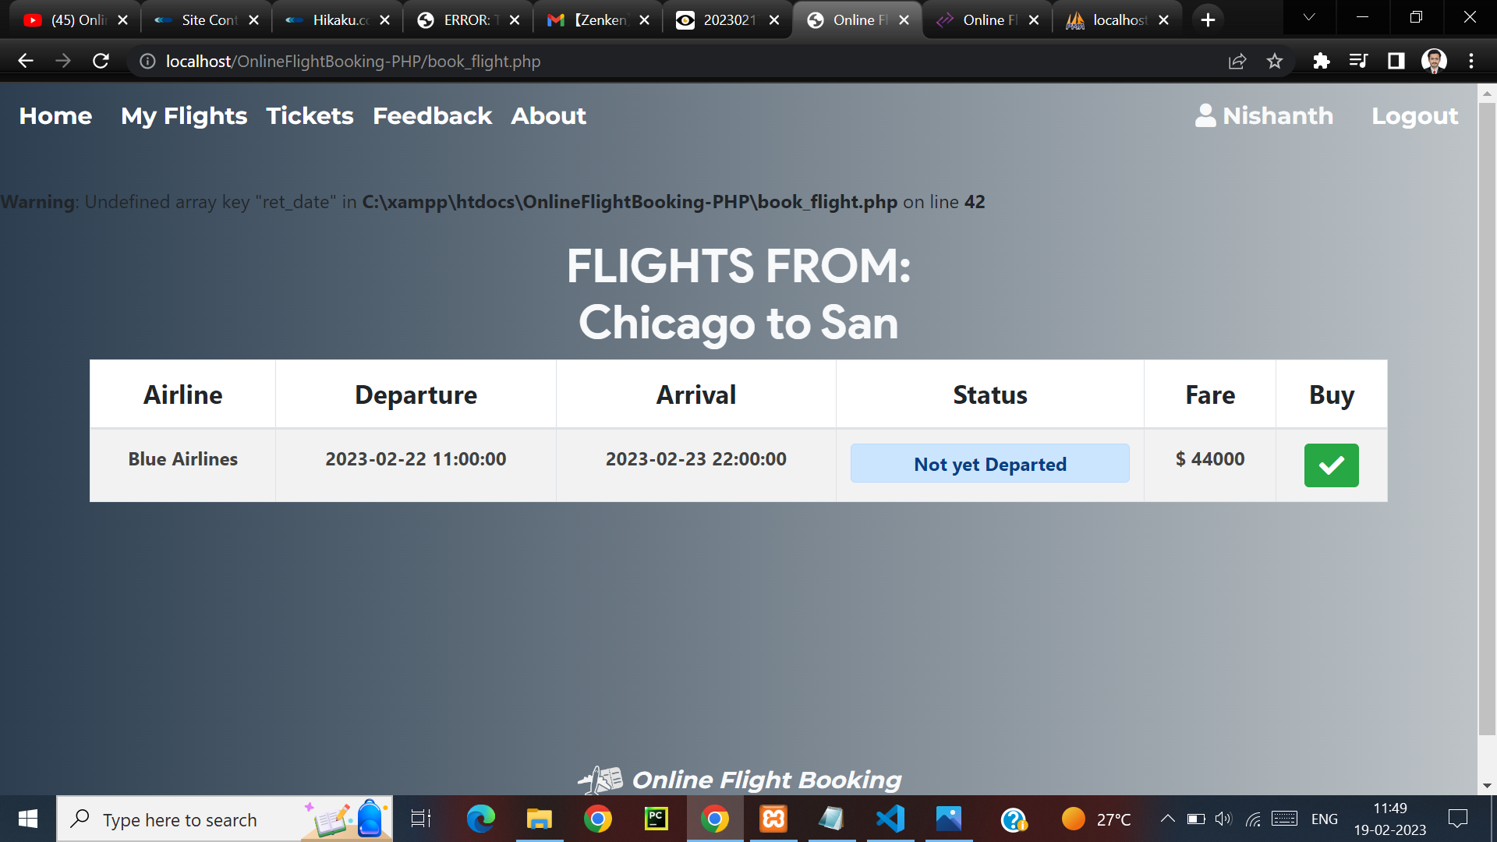
AFTER THE LOGIN OPTION COMES TO BUY THE TICKET

Slide 10
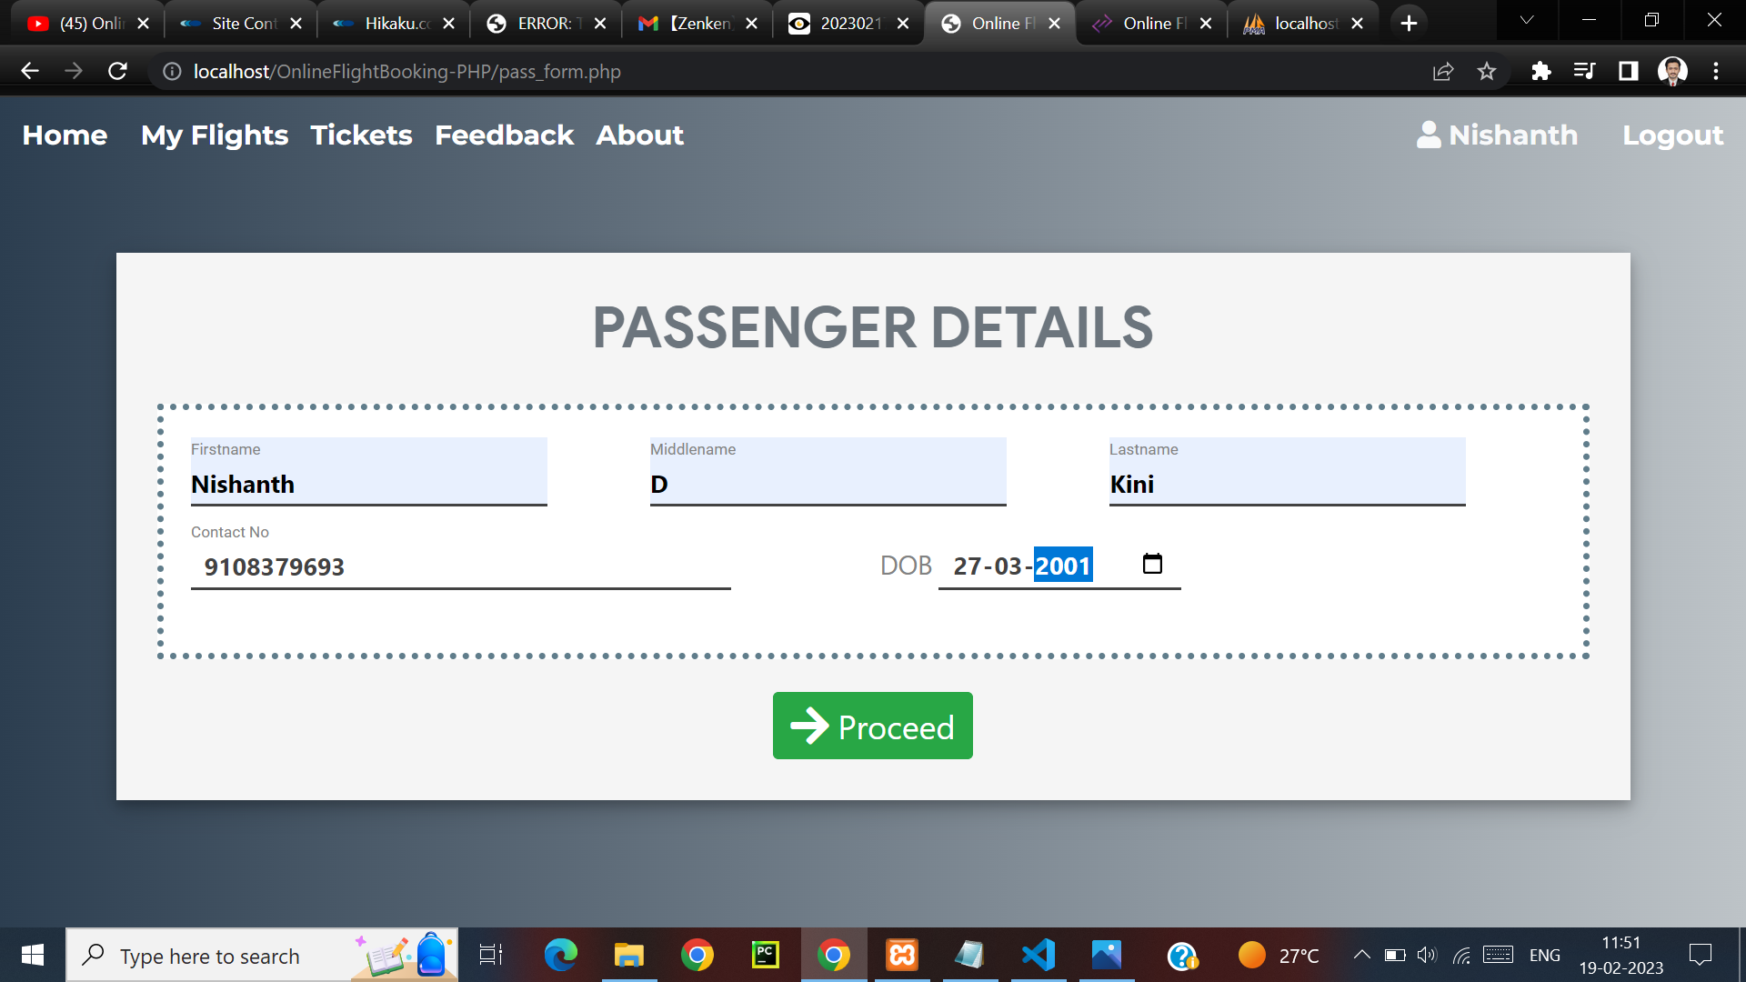
HERE U CAN GIVE YOUR DETAILS AND FINALLY BUY YOUR AIR TICKET

Slide 11
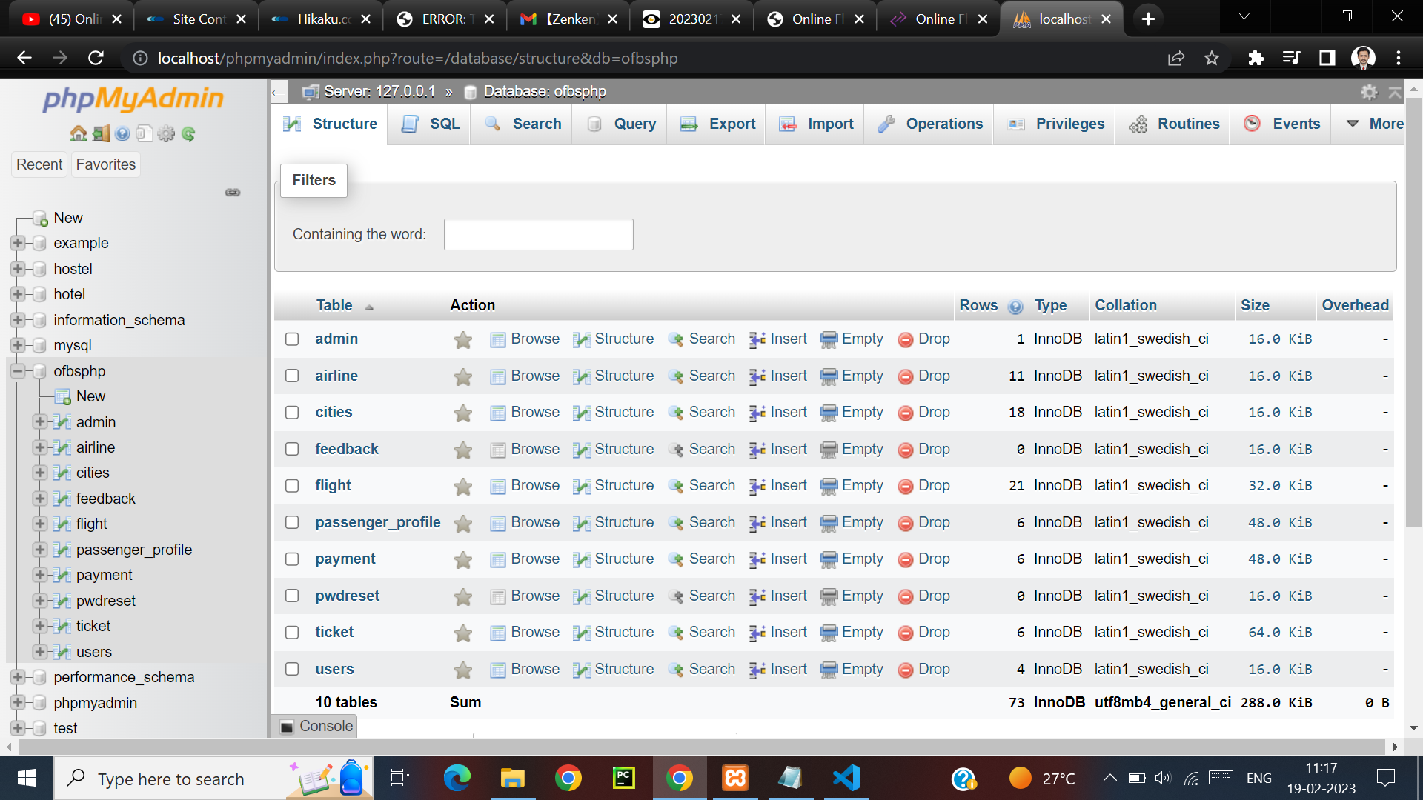
THE MYSQL PART

Slide 12
THANK YOU

